Slide 1
Welcome

Slide 2
Layouts and resources for the UI

Slide 3
View
View Group

Slide 4
View
Every element that you see is a View

Slide 5

View
Every element that you see is a View

Slide 6
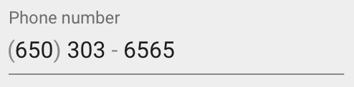
View
Every element that you see is a View

Slide 7

View
Every element that you see is a View

Slide 8

View
Every element that you see is a View

Slide 9

View
Every element that you see is a View

Slide 10

View
Every element that you see is a View

Slide 11
View Attributes
Color
Size and position
Visibility
Interactive (respond to user clicks)
Focus (receive user input)
And more

Slide 12
View Group
Every element that you see is a View

Slide 13
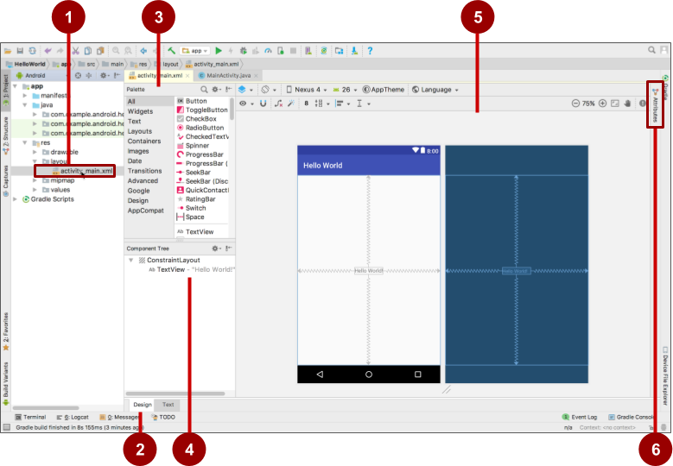
Android studio layout editor
XML layout file
Design and Text tabs
Palette pane
Component Tree
Design and blueprint panes
Attributes tab

Slide 14
View Group
Something contains multiple Views.
To have a ViewGroup you need for a Layout.

Slide 15
Layouts
Subclasses of ViewGroup
Contains views

Slide 16



Common Layout Classes
LinearLayout
ConstraintLayout
RelativeLayout
Notes:
ConstraintLayout: Connect views with constraints
LinearLayout: Horizontal or vertical row
RelativeLayout: Child views relative to each other

Slide 17
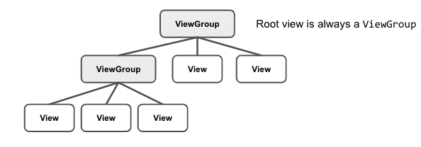
Hierarchy of ViewGroup and Views

Slide 18
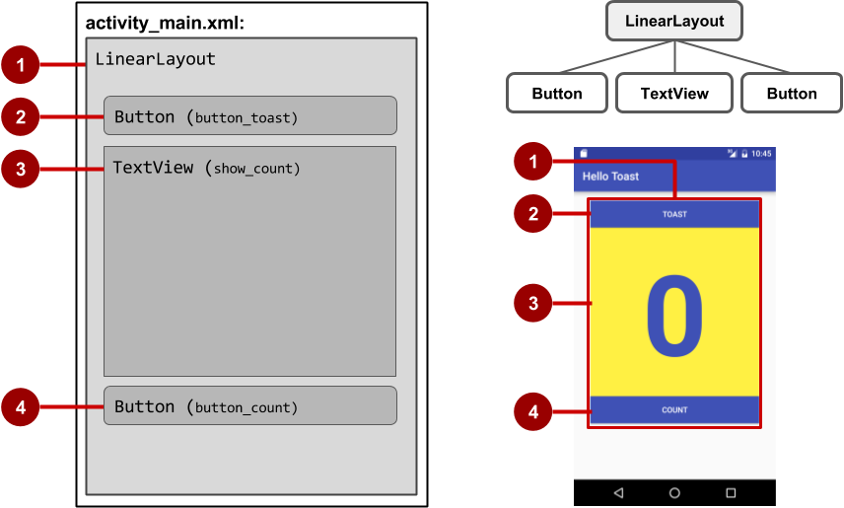
Hierarchy of screen layout

Slide 19
Hierarchy of screen layout
<LinearLayout
... >
<Button
... />
<TextView
... />
<Button
... />
</LinearLayout>

Slide 20
Constraint Layout

Slide 21
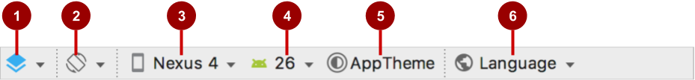
Layout editor
Select Design Surface: Design and Blueprint panes
Orientation in Editor: Portrait and Landscape
Device in Editor: Choose device for preview
API Version in Editor: Choose API for preview
Theme in Editor: Choose theme for preview
Locale in Editor: Choose language/locale for preview

Slide 22
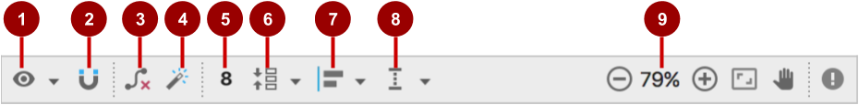
Constraint Layout Tool
Show: Show Constraints and Show Margins
Autoconnect: Enable or disable
Clear All Constraints: Clear all constraints in layout
Infer Constraints: Create constraints by inference
Default Margins: Set default margins
Pack: Pack or expand selected elements
Align: Align selected elements
Guidelines: Add vertical or horizontal guidelines
Zoom controls: Zoom in or out

Slide 23

Autoconnect

Slide 24
Align elements by baseline

Slide 25
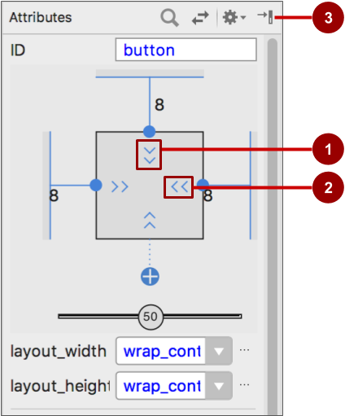
Align elements by baseline
Vertical view size control specifies layout_height
Horizontal view size control specifies layout_width
Attributes pane close button

Slide 26



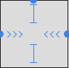
Align elements by baseline
layout_width and layout_height change with size controls
match_constraint: Expands element to fill its parent
wrap_content: Shrinks element to enclose content
Fixed number of dp (density-independent pixels)

Slide 27
TextView example

Slide 28
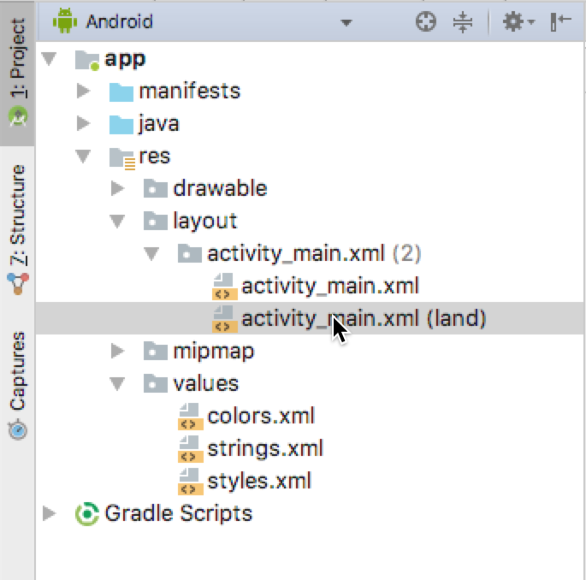
Landscape variant

Slide 29
Thanks

